Slide 1
CIS041-3 Advanced Information Technology
Clouds Computing and BDA
Gangmin Li
(Office hours: 13:00-17:00 every Friday)

Slide 2
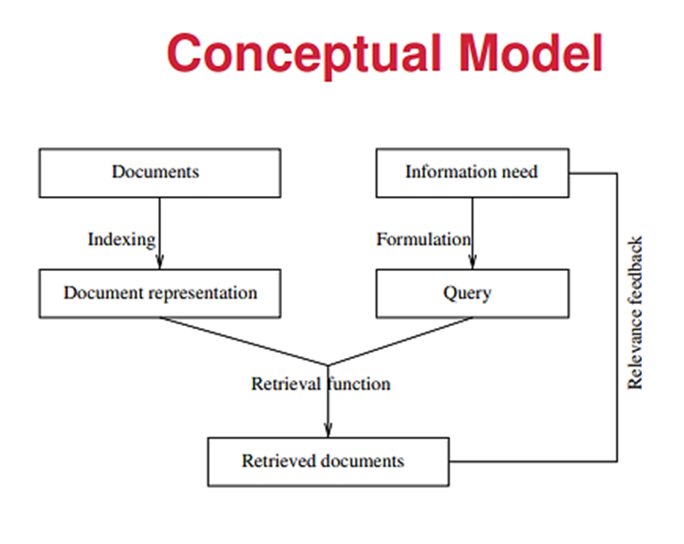
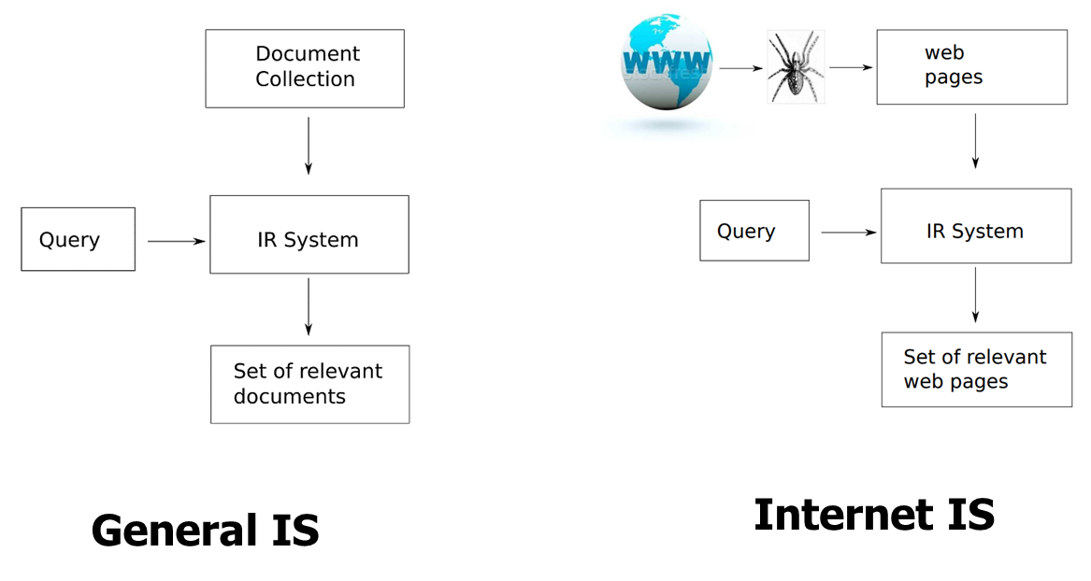
What we have learnt
information: meaning of data and basic elements to gain knowledge and wisdom
Information technology: the use of computers/networks to create, process, store, retrieve, and exchange all kinds of data and information (IT as a synonym for computers and computer networks)
IT used/developed for Information systems: General IS and Internet IS
IR are techniques adopted by computer systems to satisfy information needs

Slide 3
Issues with IS
Storage
Computation

Slide 4
5 New Information Technology Advances
Artificial Intelligence
Cloud Computing
Machine Learning
The Internet of Things
Virtual Reality

Slide 5
Outline
Clouds Computing (NIST definition)
5 essential characteristics,
3 service models, and
4 deployment models
BDA (Big Data Analytics)
Misconception of BDA
Hadoop and MapReduce

Slide 6
Clouds Computing
Provide physical solution for IT resources demands (commutation and storage)

Slide 7

Clouds computing

Slide 8
Definition
“Cloud computing is a model for enabling convenient, on-demand network access to a shared pool of configurable computing resources (e.g., networks, servers, storage, applications, and services) that can be rapidly provisioned and released with minimal management effort or service provider interaction. This cloud model promotes availability and is composed of five essential characteristics, three service models, and four deployment models.”
– (NIST, USA)

Slide 9
Why Clouds?
Concept of clouds is around 2000, but Grid computing, sharing and rent computation is long ago. Bask to 1960 …
Resources demand vs Resources waste (sharing)
Rent (PAYG) idea
Ubiquitous computing: Anywhere, anytime, …
Pervasive computing
Unitality computing
On-demand computing

Slide 10
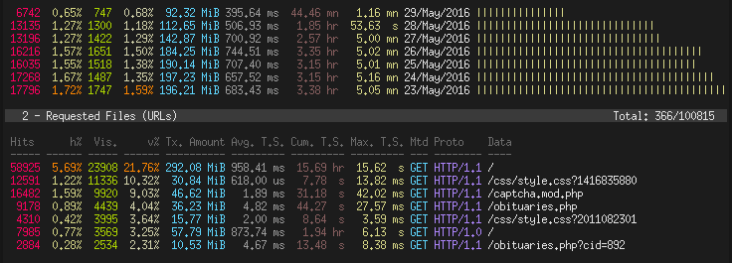
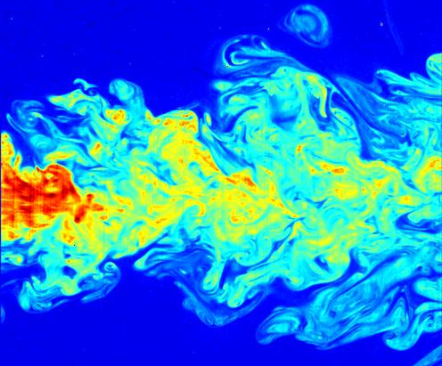


Applications
Web data analysis
Scientific and economic big data analyses

Slide 11
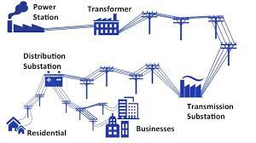
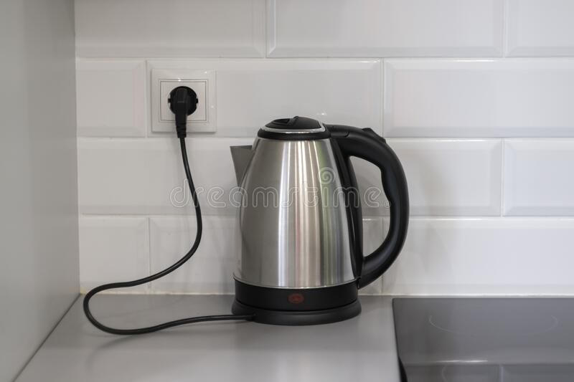
Grid Computing
Grid computing is a group of networked computers that work together as a virtual supercomputer to perform large tasks, such as analysing huge sets of data or modelling complex systems like aerodynamics, fluid dynamics, whether systems.

Slide 12
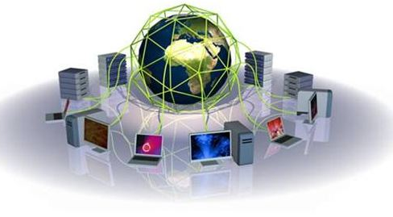
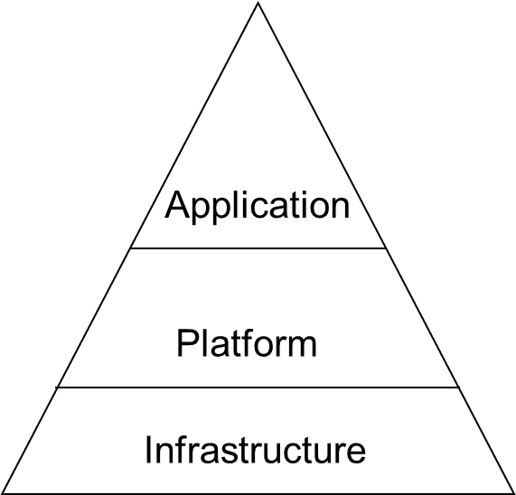
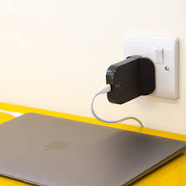
Grid computing
Mainframe → PC → Cloud
Utility services

Slide 13
Three cornerstones of Grid computing
Decentralised, local, and global coordination of resources such as computer clusters, data analytics, mass storage, and databases.
Standardised, open interfaces (nodes) and middleware (protocols or protocol bundles) that connect computing units to the main grid and distribute tasks.
Provision of non-trivial quality-of-service (QoS) to optimally distribute data streams and ensure constant scalability and reliable data transfer under high computational demands.

Slide 14
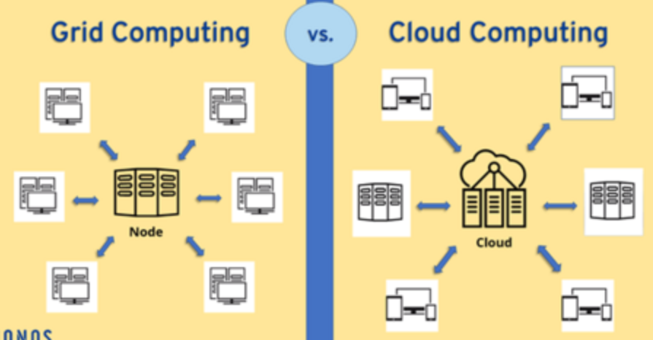
Clouds vs. Grid
Grid computing distributes processes non-centrally to coupled resources, cloud computing uses centrally hosted cloud servers.

Slide 15
Advantages of Clouds
Lower cost
hw/sw/maintenance
Applications as components
No upfront investment in software/hardware infrastructure
No need to build a proprietary infrastructure for a peak load
Flexible scalability
Higher utilization.
Improved reliability.

Slide 16
5 Essential characteristics
Rapid elasticity. Capabilities can be rapidly and elastically provisioned, in some cases automatically, to quickly scale out and rapidly released to quickly scale in. To the consumer, the capabilities available for provisioning often appear to be unlimited and can be purchased in any quantity at any time.
On-demand self-service. A consumer can unilaterally provision computing capabilities, such as server time and network storage, as needed automatically without requiring human interaction with each service’s provider.
Measured Service. Cloud systems automatically control and optimize resource use by leveraging a metering capability at some level of abstraction appropriate to the type of service (e.g., storage, processing, bandwidth, and active user accounts). Resource usage can be monitored, controlled, and reported providing transparency for both the provider and consumer of the utilized service.
*NIST Definition of Cloud Computing”, Peter Mell and Tim Grance, Information Technology Laboratory, 10-7-09

Slide 17
5 Essential characteristics
Broad network access. Capabilities are available over the network and accessed through standard mechanisms that promote use by heterogeneous thin or thick client platforms (e.g., mobile phones, laptops, and PDAs).
Resource pooling. The provider’s computing resources are pooled to serve multiple consumers using a multi-tenant model, with different physical and virtual resources dynamically assigned and reassigned according to consumer demand. There is a sense of location independence in that the customer generally has no control or knowledge over the exact location of the provided resources but may be able to specify location at a higher level of abstraction (e.g., country, state, or datacenter). Examples of resources include storage, processing, memory, network bandwidth, and virtual machines.

Slide 18
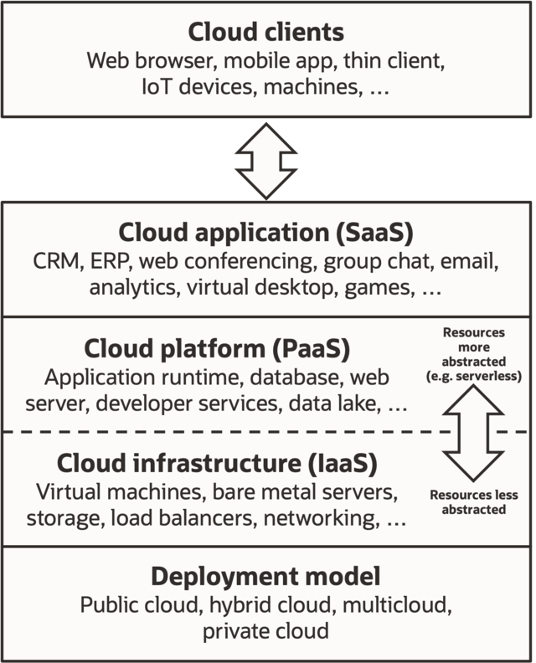
3 Service models
Software as a Service (SaaS)
Platform as a Service (PaaS)
Infrastructure as a Service (Iaas)

Slide 19
SaaS
Software as a Service (SaaS) is the delivery of applications as a service, probably the version of cloud computing that most people are used to on a day-to-day basis. The underlying hardware and operating system is irrelevant to the end user, who will access the service via a web browser or app; it is often bought on a per-seat or per-user basis.
Examples
Gmail, Google Apps
SalesForce.com
Youtube
Facebook

Slide 20
PaaS
Delivers a platform rather than a service
API for developers
Services are limited by APIs capabilities
Examples
Google App Engine
Mosso (Rackspace)
Server platforms on demand

Slide 21
IaaS
Computer hardware (typically set up as a grid for massive horizontal scalability)
Physical footprint/hardware
Client has control over operating system, applications, firewalls)
Client has no control over underlying cloud infrastructure
Examples: physical or virtual servers, storage and networking.

Slide 22
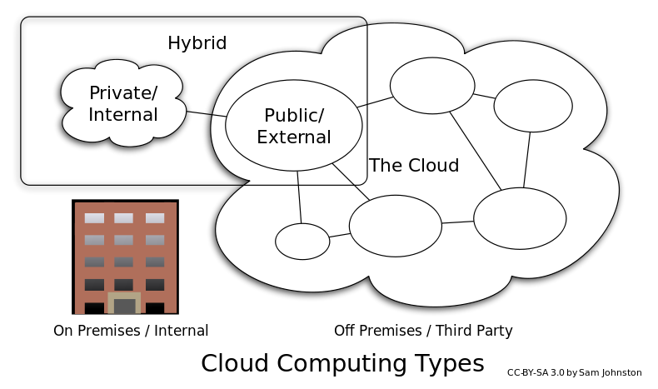
4 Deploy models
HPC cloud
Big data cloud

Slide 23
4 Deploy models: Private Clouds
Private cloud: A private cloud refers to cloud computing resources used exclusively by a single business or organization.
A private cloud can be physically located on the company’s on-site data center.
Some companies also pay third-party service providers to host their private cloud.
A private cloud is one in which the services and infrastructure are maintained on a private network.

Slide 24
4 Deploy models: Public Clouds
Public cloud: Public clouds are owned and operated by a third-party cloud service providers, which deliver their computing resources, like servers and storage, over the Internet.
Microsoft Azure is an example of a public cloud. With a public cloud, all hardware, software, and other supporting infrastructure is owned and managed by the cloud provider.
You access these services and manage your account using a web browser.

Slide 25
4 Deploy models: Hybrid
Hybrid cloud: is a composition of a public cloud and a private environment, such as a private cloud or on-premises resources, offering the benefits of multiple deployment models.
Hybrid cloud can also mean the ability to connect collocation, managed and/or dedicated services with cloud resources.
A hybrid cloud service crosses isolation and provider boundaries so that it can't be simply put in one category of private, public, or community cloud service.
It allows one to extend either the capacity or the capability of a cloud service, by aggregation, integration or customization with another cloud service.

Slide 26
4 Deploy models: Community
Community cloud: is a composition of a public cloud and a private environment, such as a private cloud or on-premises resources, offering the benefits of multiple deployment models.
Hybrid cloud can also mean the ability to connect collocation, managed and/or dedicated services with cloud resources.
A hybrid cloud service crosses isolation and provider boundaries so that it can't be simply put in one category of private, public, or community cloud service.
It allows one to extend either the capacity or the capability of a cloud service, by aggregation, integration or customization with another cloud service.

Slide 27
Foundational Elements of Cloud Computing
Virtualization
Grid technology
Service Oriented Architectures
Distributed Computing
Broadband Networks
Browser as a thin client or service interface

Slide 28
Examples
AWS: Amazon web services
Amazon EC2
Amazon S3
Amazon SimpleDB
Amazon SQS
Amazon CloudFront
Elastic IP
Google App Engine:
App Engine (https://cloud.google.com/)
google Colab. (https://colab.research.google.com/)
Microsoft:
Azure.

Slide 29
BDA
Provide revolutionary methods for using Distributed computing (clouds computing) and parallel execution for Big Data

Slide 30

Big Data

Slide 31
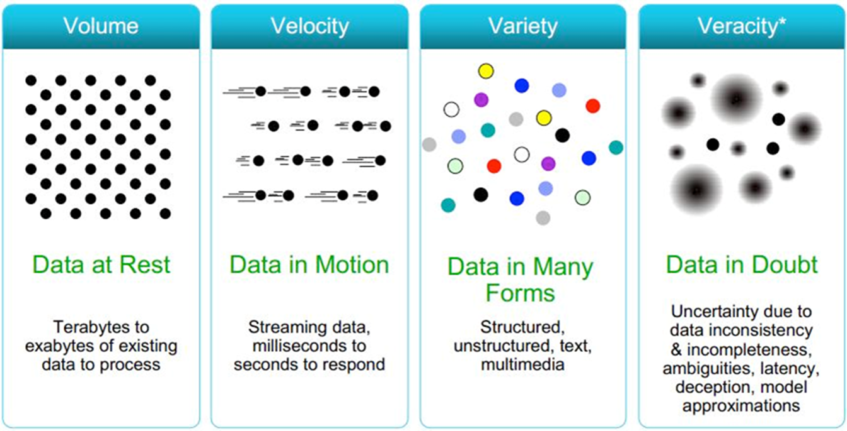
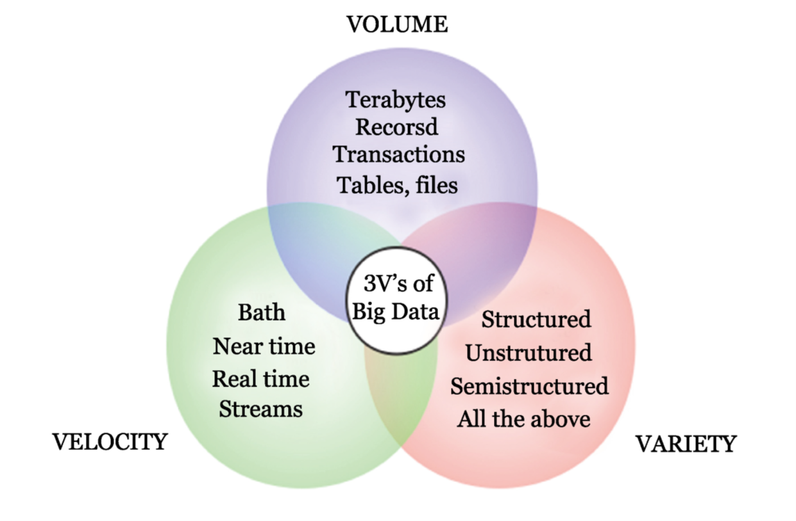
Definition
Big Data actually mean Big data analytics!
Big data: 3Vs, 4Vs, 5Vs definition
from various sources, has different formats, is generated at a variable rate, and may also contain inconsistencies.

Slide 32
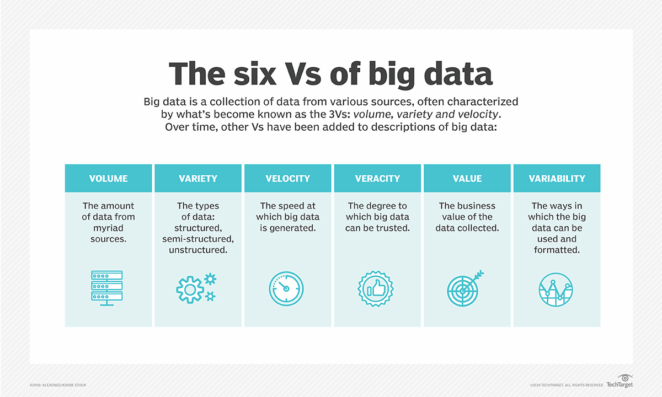
6Vs

Slide 33
What is Big Data Analytics?
It examines large and different types of data to uncover hidden patterns, correlations and other insights for a good business decision-making.
It involves a fixed process that help to achieve analytic results.
It applies various analytic methods/algorithms on the given set of data to achieve different goals (describe, explore, predict, …)
Use Big Data Analytics tools to analyse the data fast and accurately: Hadoop, Pig, Apache Spark,

Slide 34
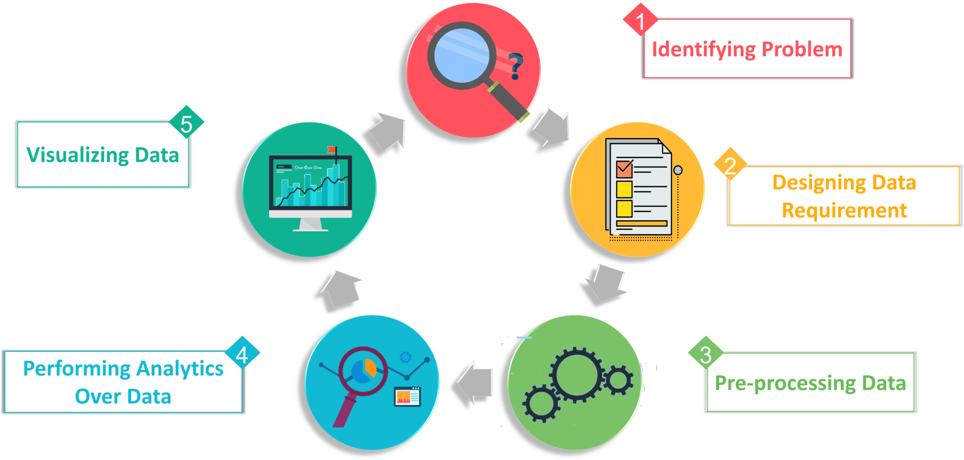
BDA process
Understand problem
Data Reporting
Understand data
Data analysing
Data process

Slide 35
BDA methods

Slide 36
BDA method: Descriptive Analytics
Descriptive Analytics: It uses data aggregation and data mining to provide insight into the past and answer: “What has happened?” The descriptive analytics does exactly what the name implies they “describe” or summarize raw data and make it interpretable by humans.

Slide 37
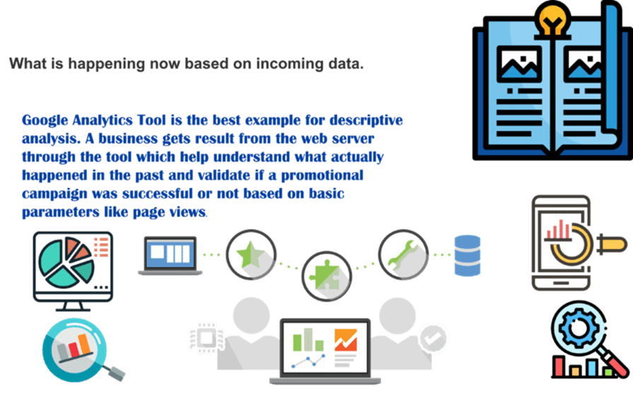
Example

Slide 38
BDA method: Diagnostic Analytics
Diagnostic Analytics: It is used to determine why something happened in the past. It is characterized by techniques such as drill-down, data discovery, data mining and correlations. Diagnostic analytics takes a deeper look at data to understand the root causes of the events.

Slide 39
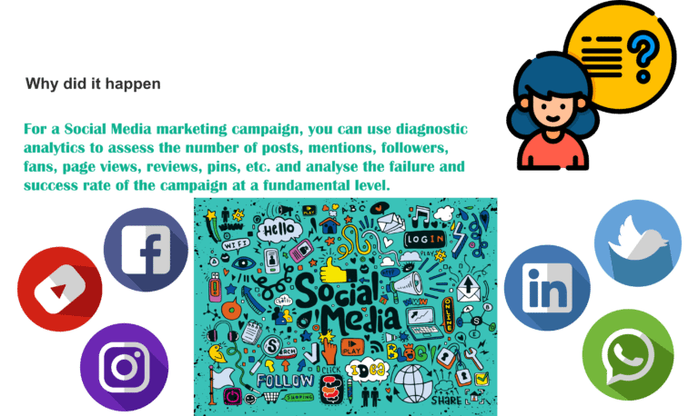
Example

Slide 40
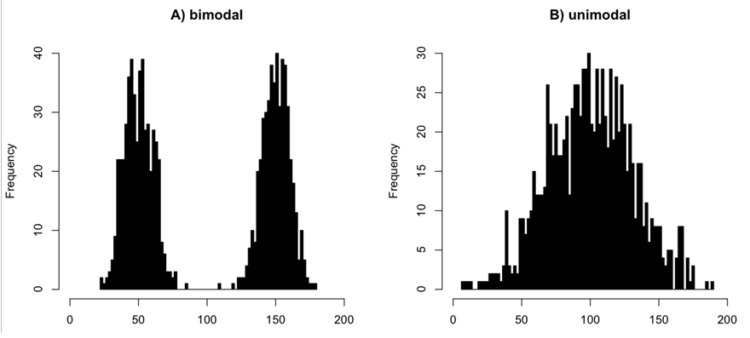
Exploratory data analysis (EDA)
Exploratory data analysis (EDA) is using graphics to examine and visualize data.
Figure 3.7 A) a bimodal distribution and b) a unimodal distribution, both of which have the same mean value of ~100.

Slide 41
BDA method: Predictive Analytics
Predictive Analytics: It uses statistical models and machine learning techniques to predict the future and answer: “What could happen?” Predictive analytics provides estimates about the likelihood of a future outcome based on past and now.

Slide 42
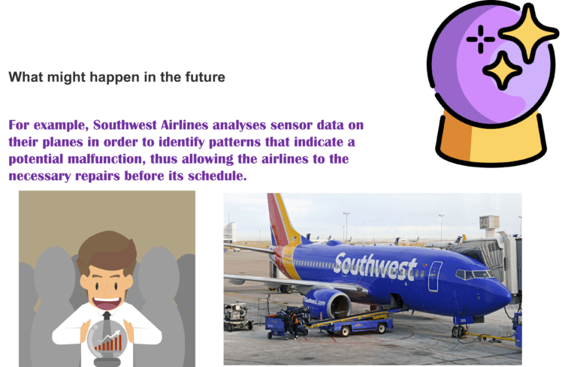
Exmples

Slide 43
BDA method: Prescriptive Analytics
Prescriptive Analytics: It uses optimization and simulation algorithms to advice on possible outcomes and answers: “What should we do?” It allows users to “prescribe” a number of different possible actions and guide them towards a solution. In a nutshell, this analytics is all about providing advice.

Slide 44
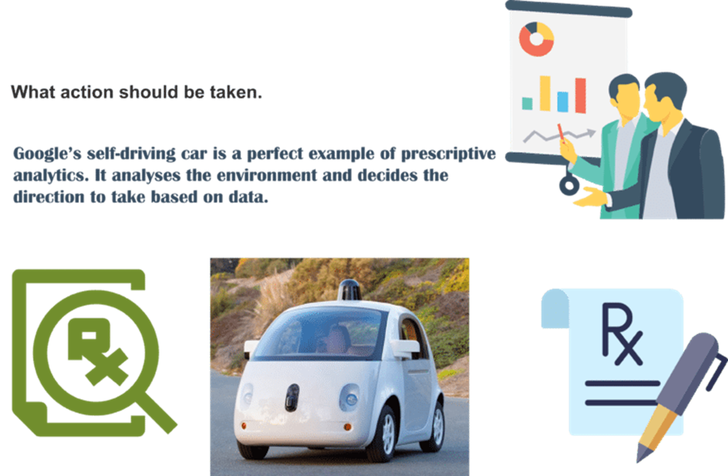
Example: google autopilot car

Slide 45
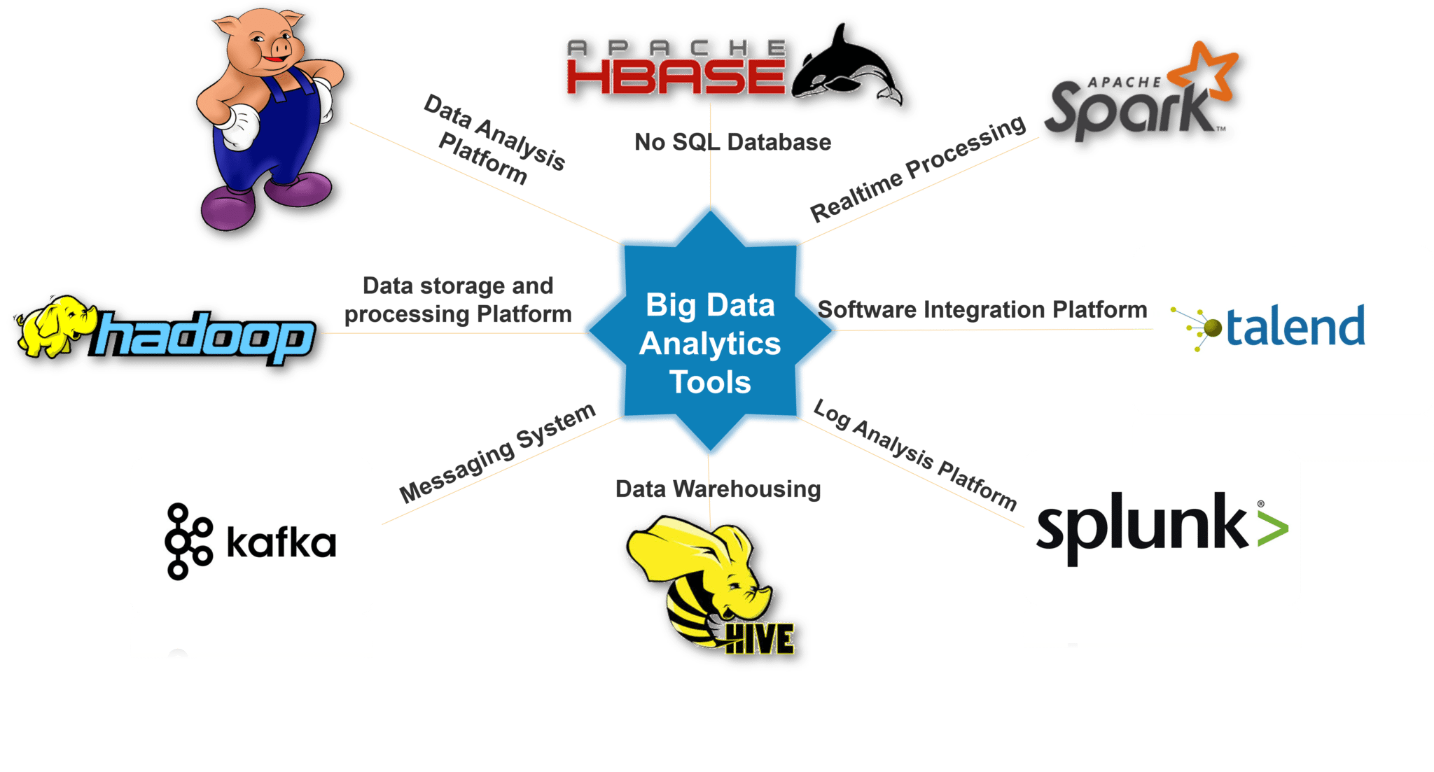
BDA Tools
These are some of the following tools used for Big Data Analytics: Hadoop, Pig, Apache HBase, Apache Spark, Talend, Splunk, Apache Hive, Kafka.

Slide 46


Hadoop

Slide 47
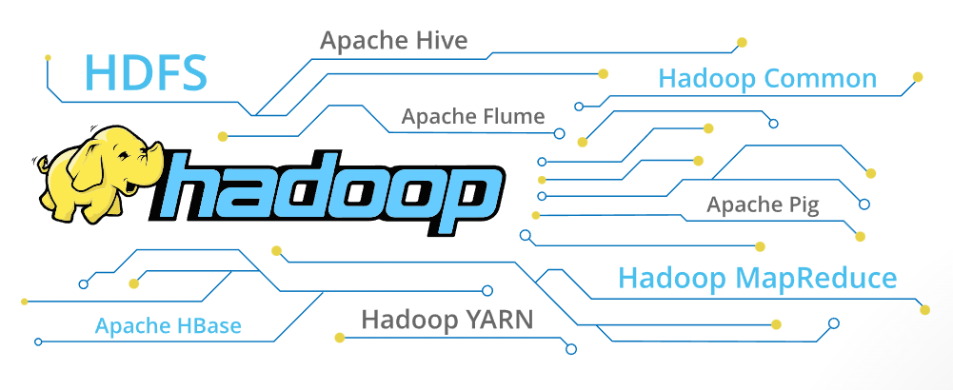
Hadoop components and ecosystem

Slide 48
Two concepts of Hadoop
Hadoop: HDSF + MapReduce (Core)
Hadoop ecosystem

Slide 49
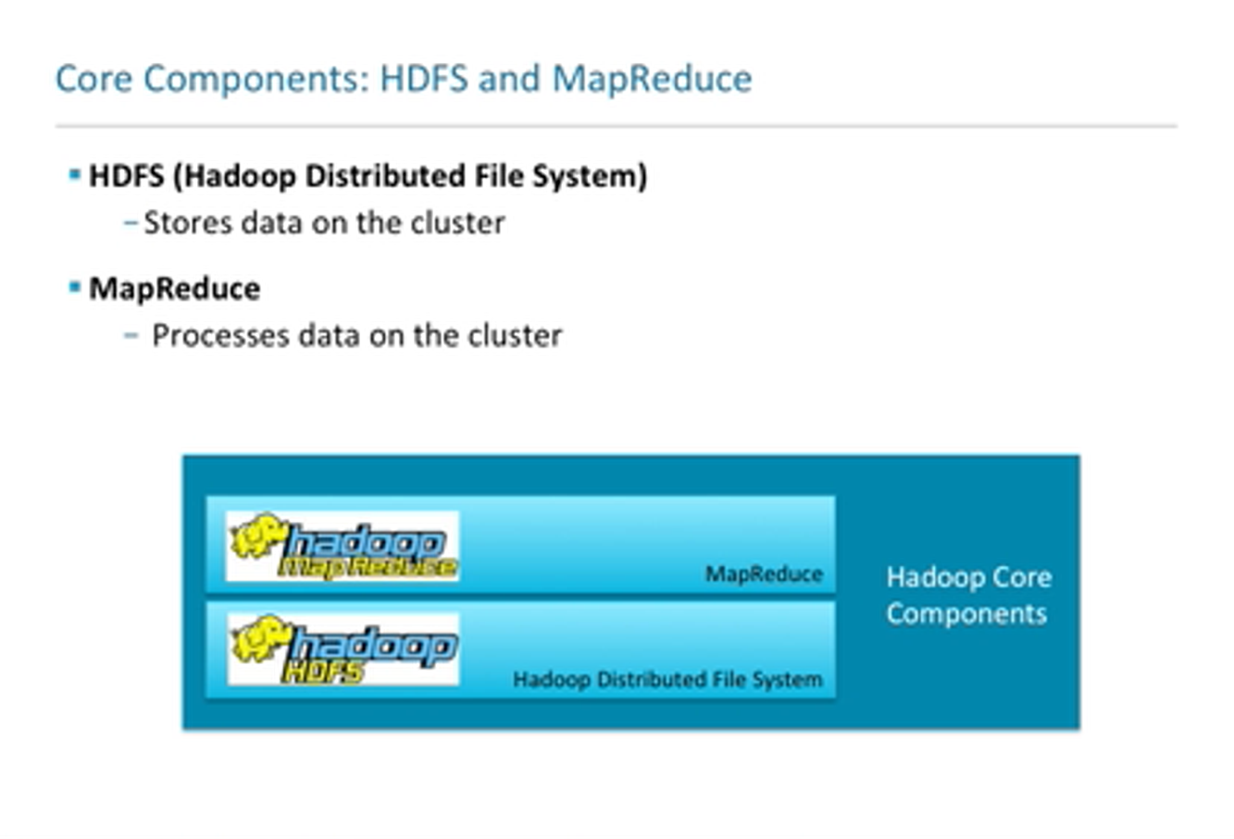

Slide 50
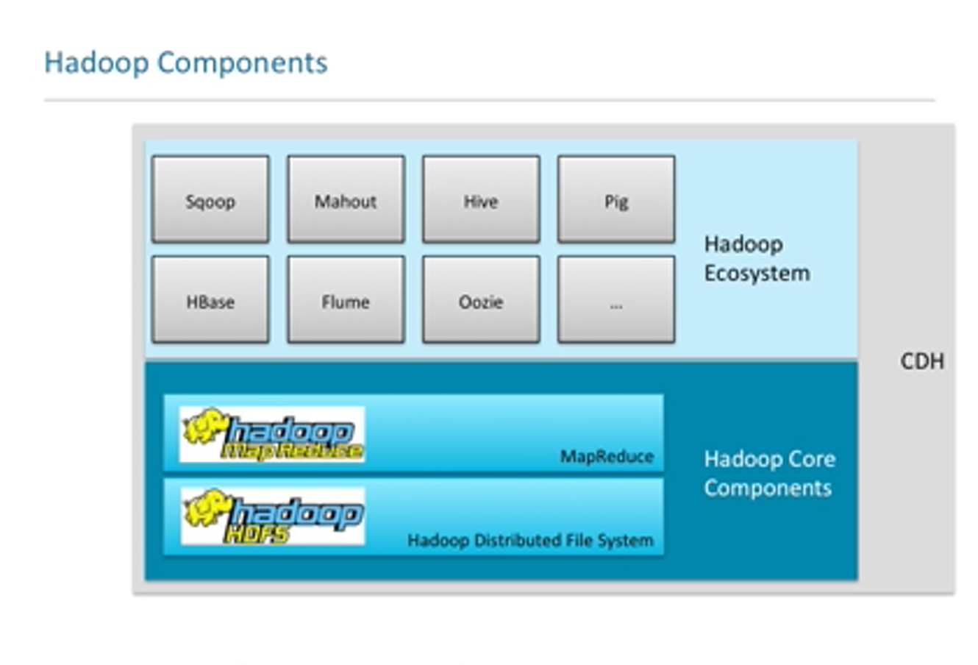

Slide 51
Hadoop core components (Core Hadoop)
Hadoop Common: provides a set of basic functions:
Java archive files (JAR), which are needed to start Hadoop,
Libraries for serialising data,
Interfaces for accessing the file system
Hadoop Distributed File System (HDFS): a highly available file system that is used to save large quantities of data in a computer cluster and is therefore responsible for storage within the framework.
MapReduce-Engine: Originally developed by Google, the MapReduce algorithm, which is implemented to provide the computing processes (job scheduling/monitoring).

Slide 52
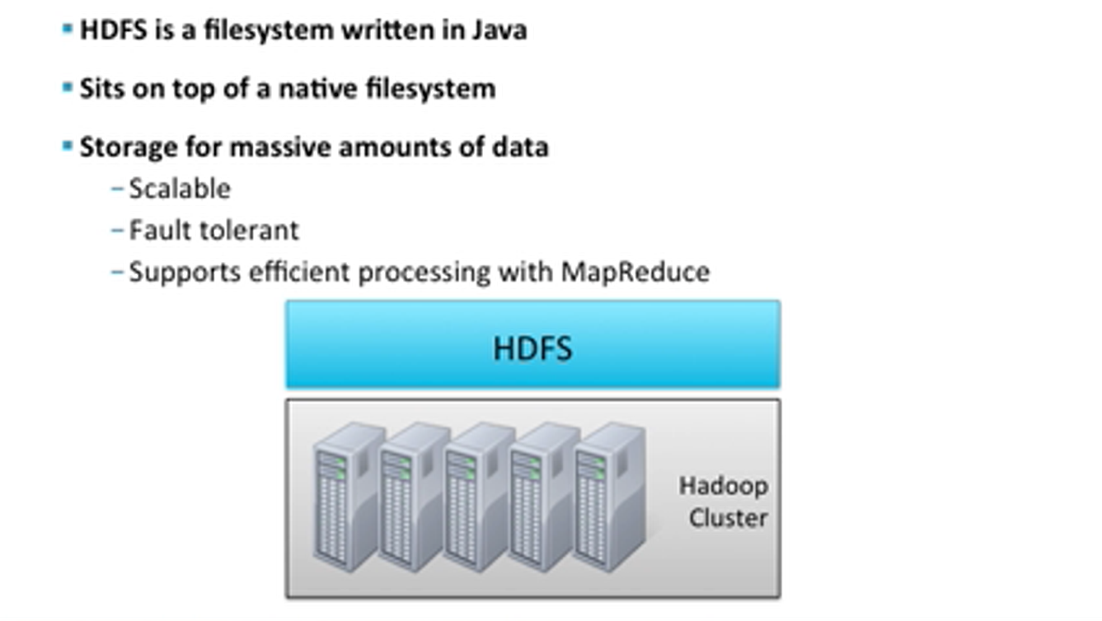
HDFS

Slide 53
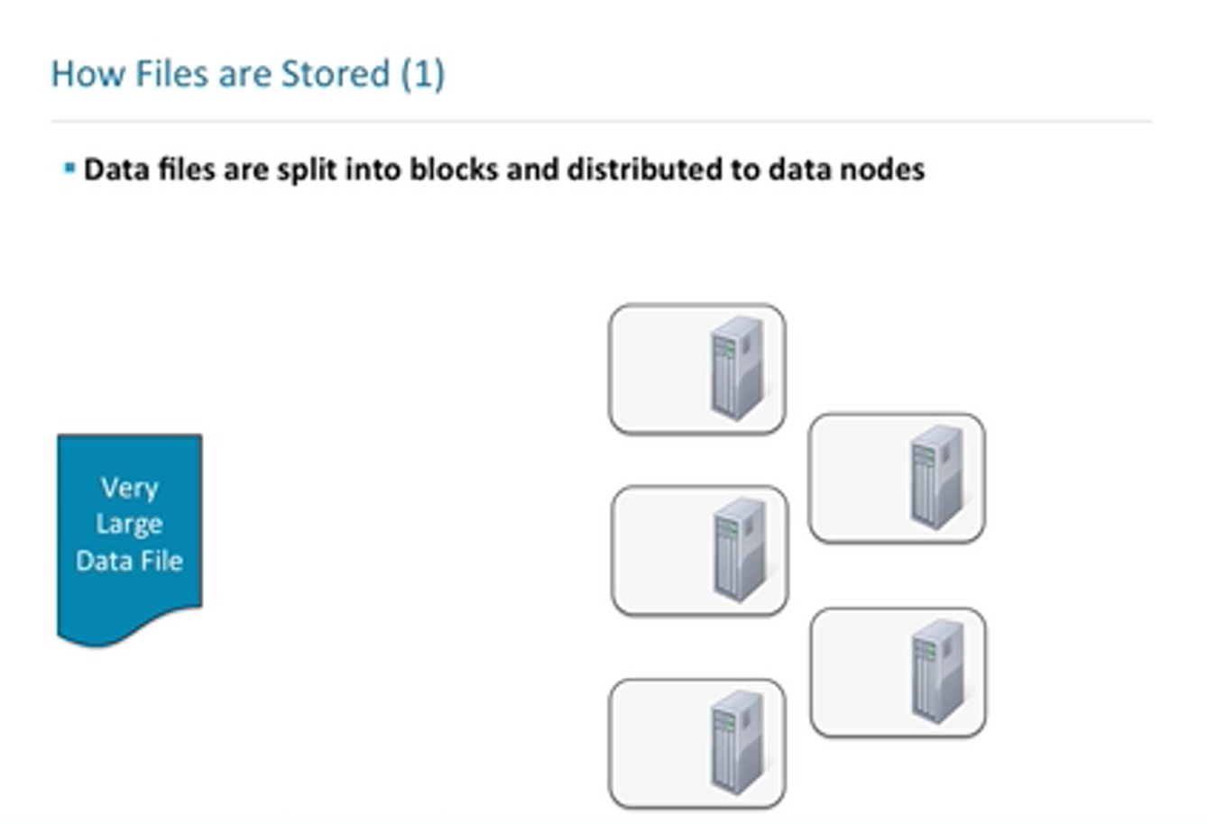

Slide 54
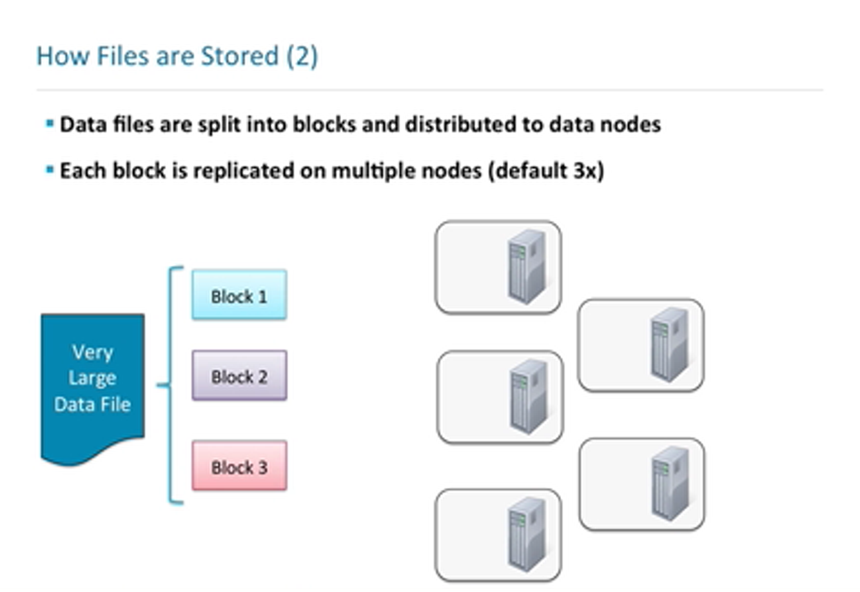

Slide 55
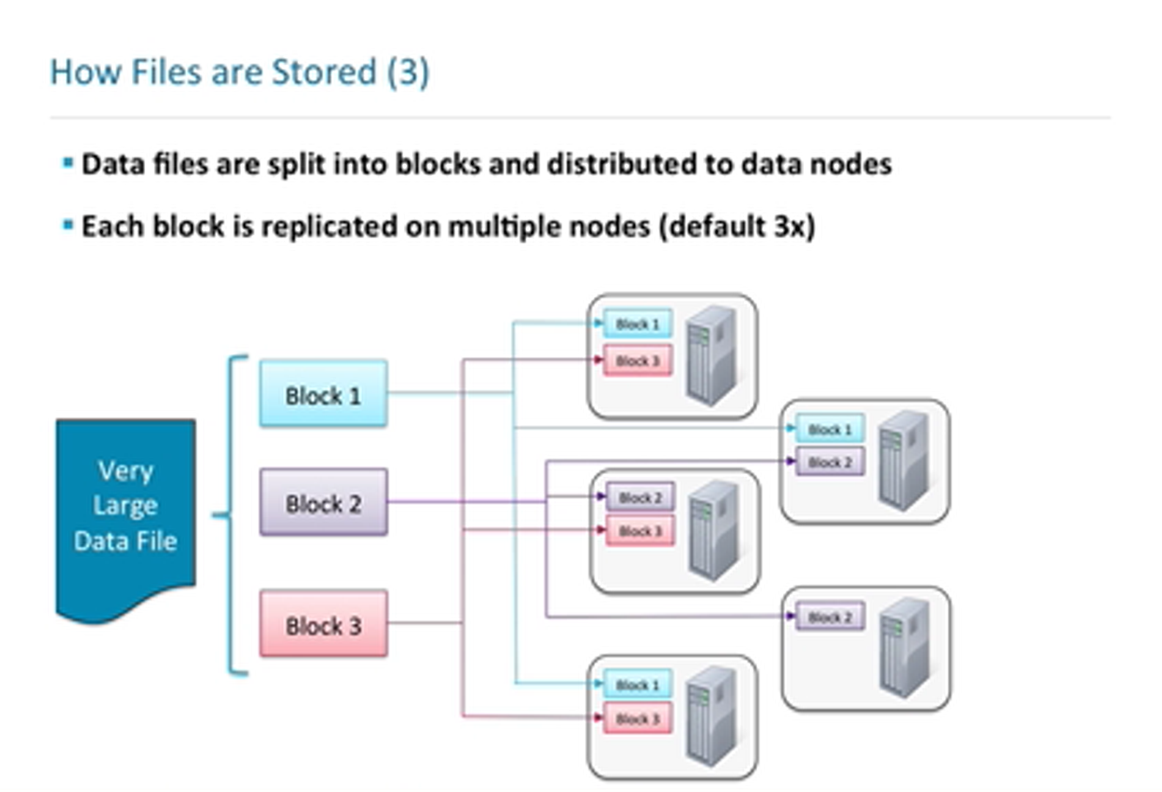

Slide 56
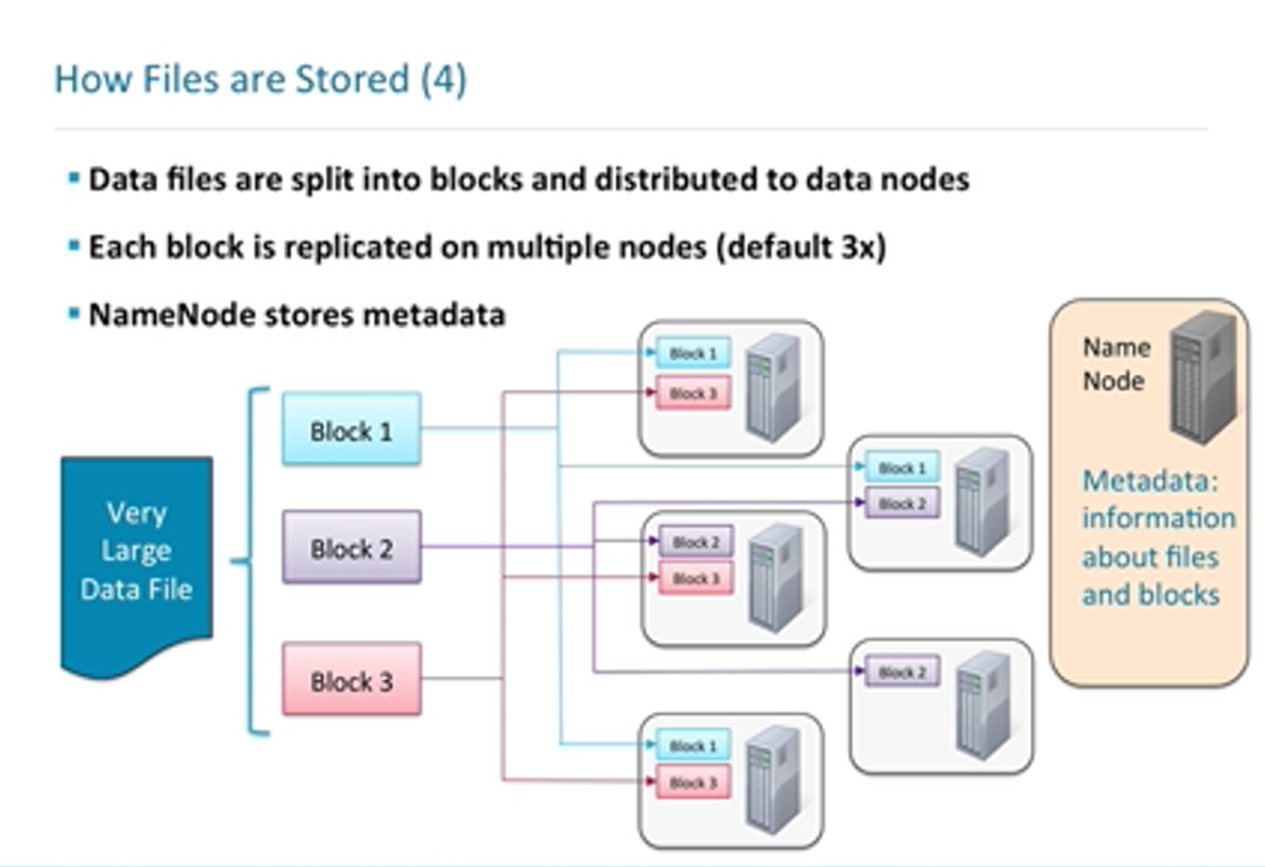

Slide 57
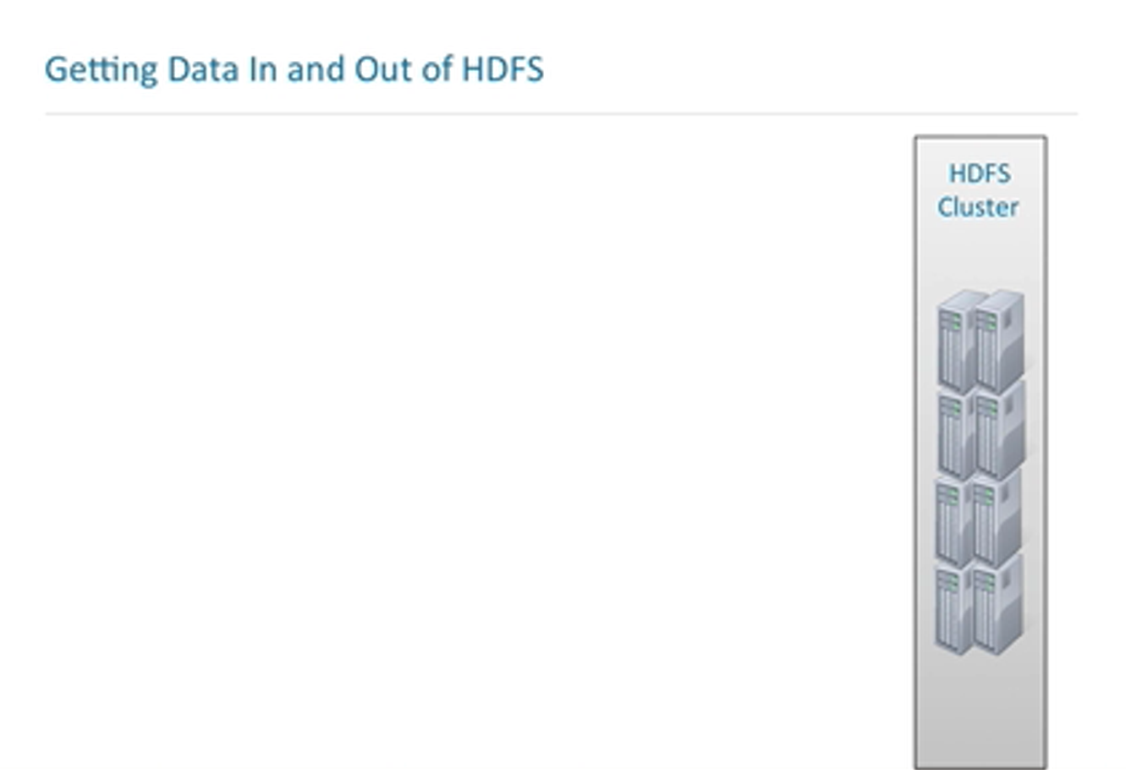
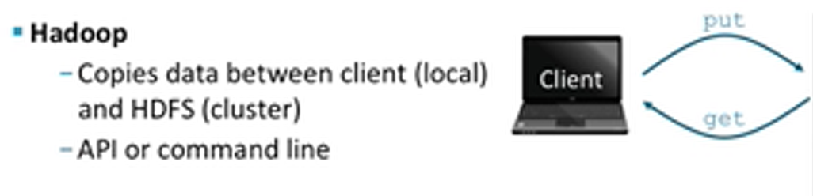
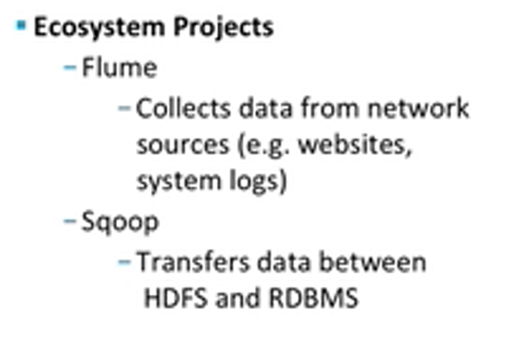
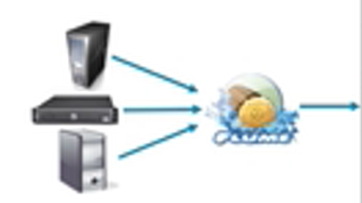
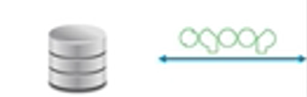
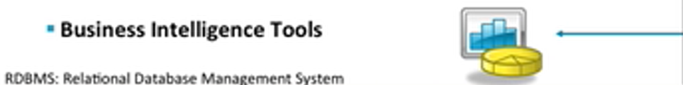
Notes:
How do you access these data?

Slide 58
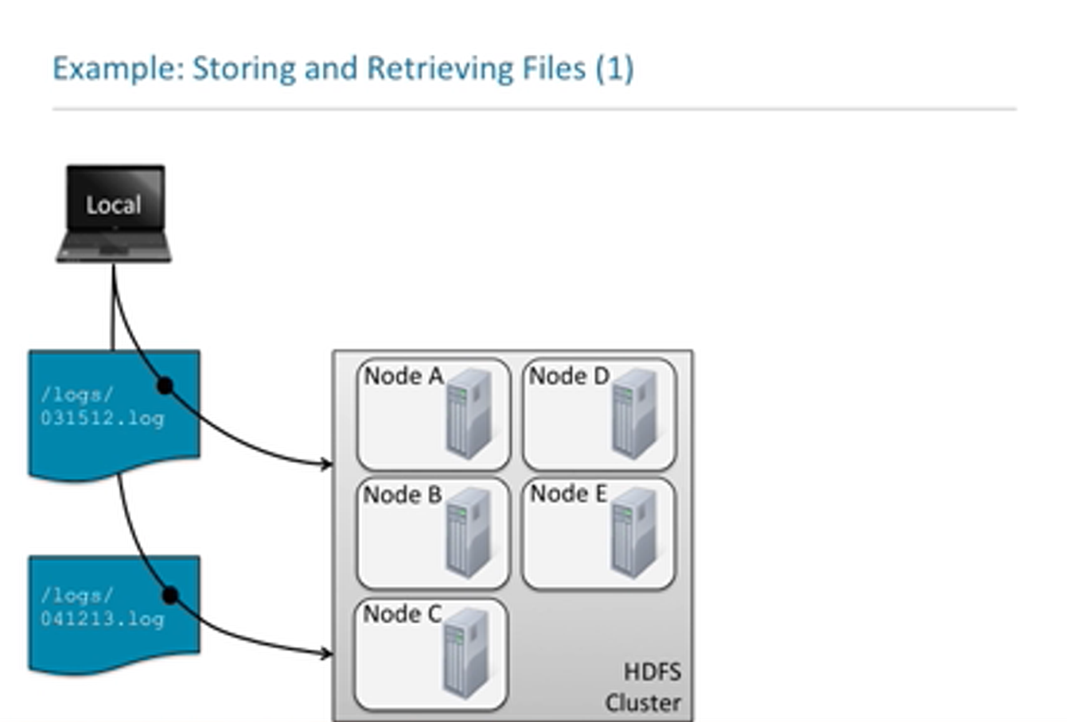

Slide 59
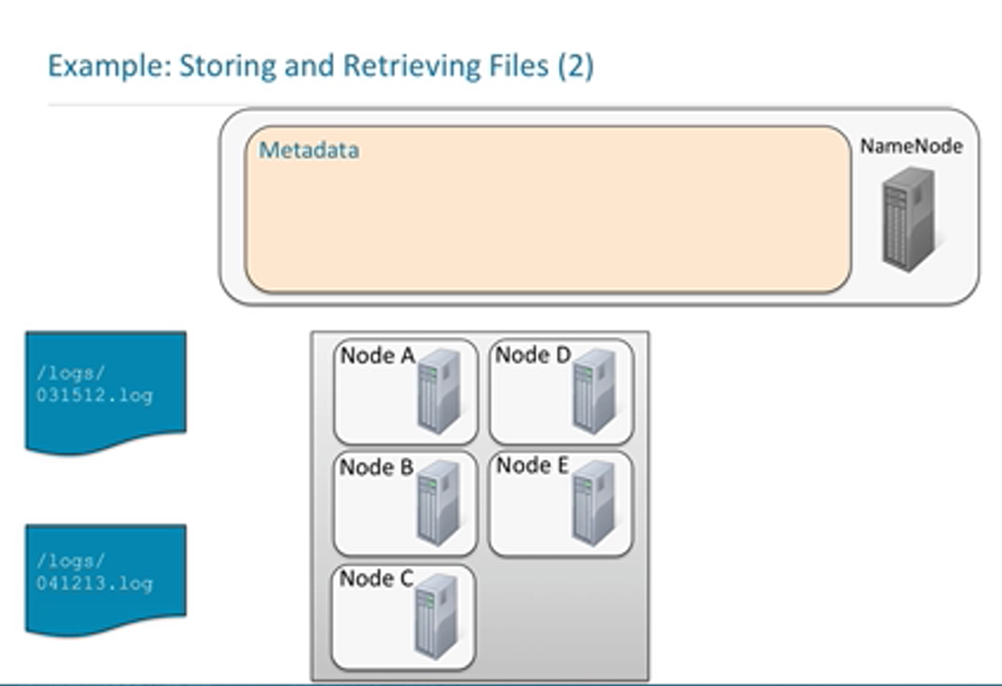
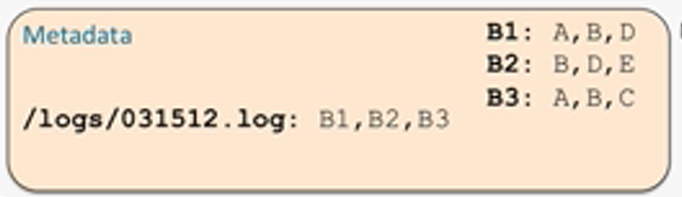
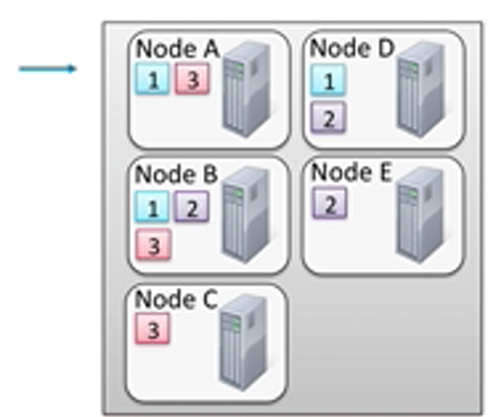


Slide 60
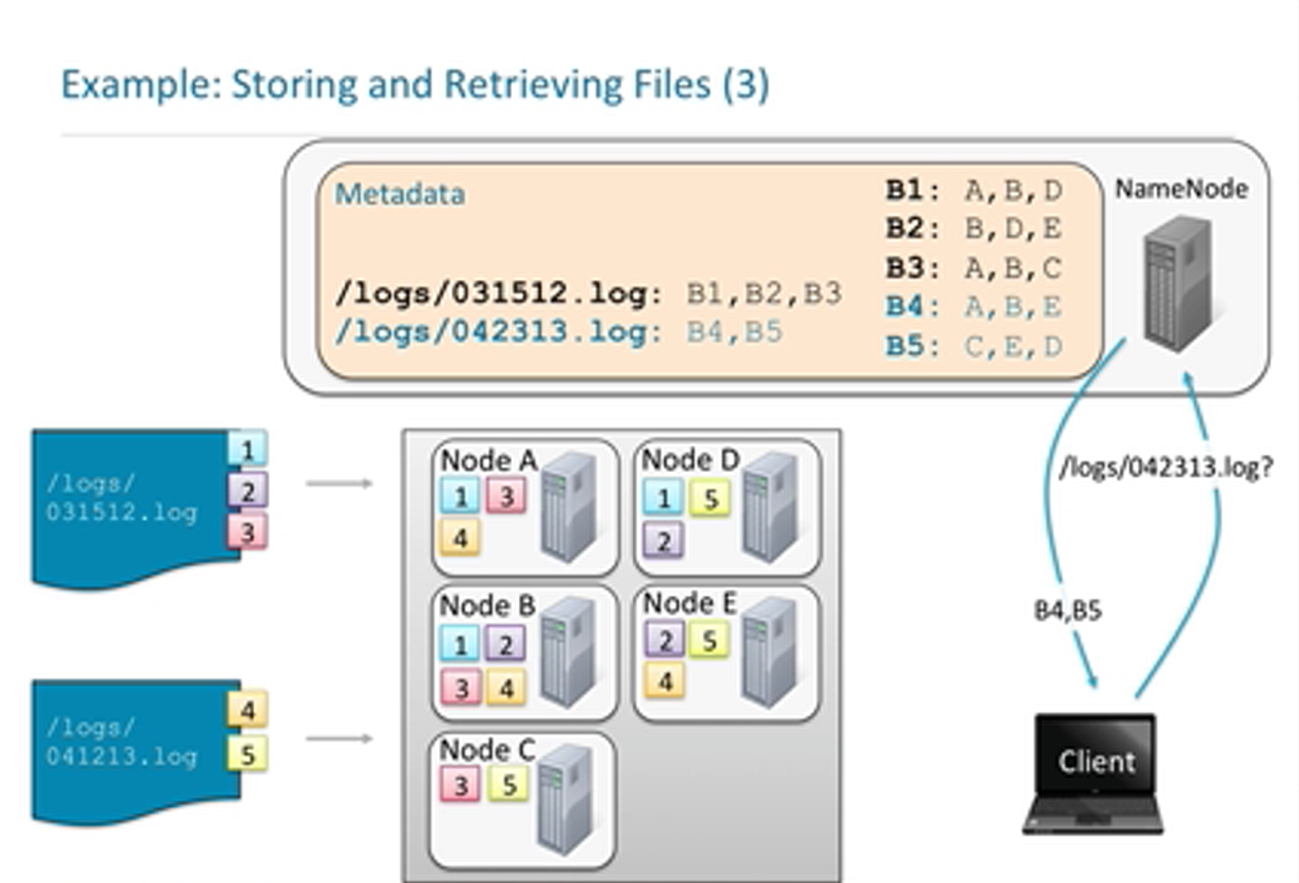

Slide 61
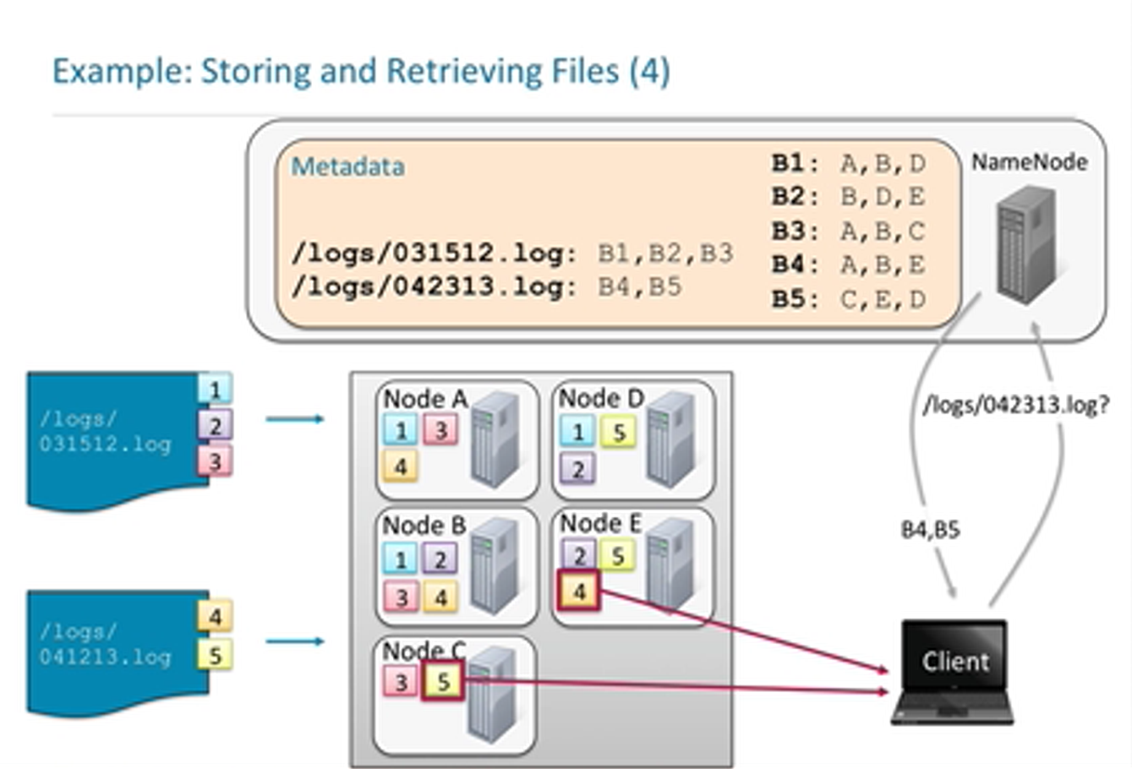

Slide 62
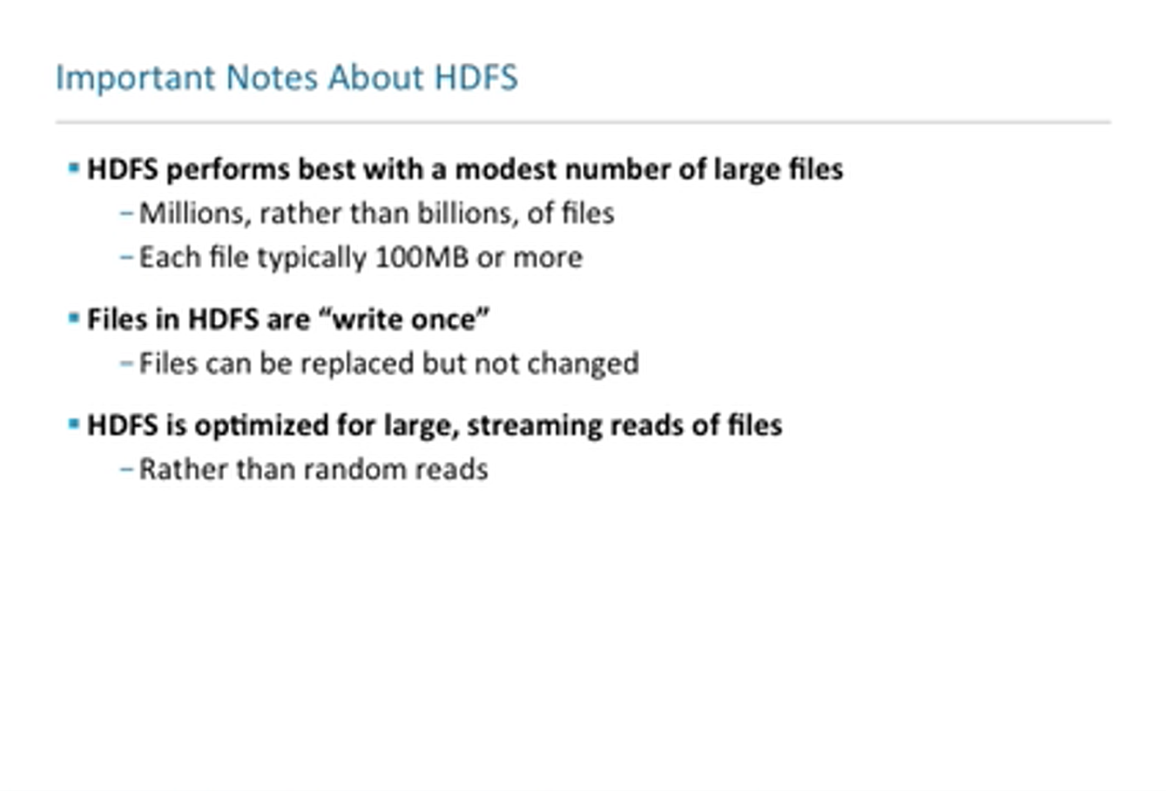

Slide 63
How MapReduce works?

Slide 64
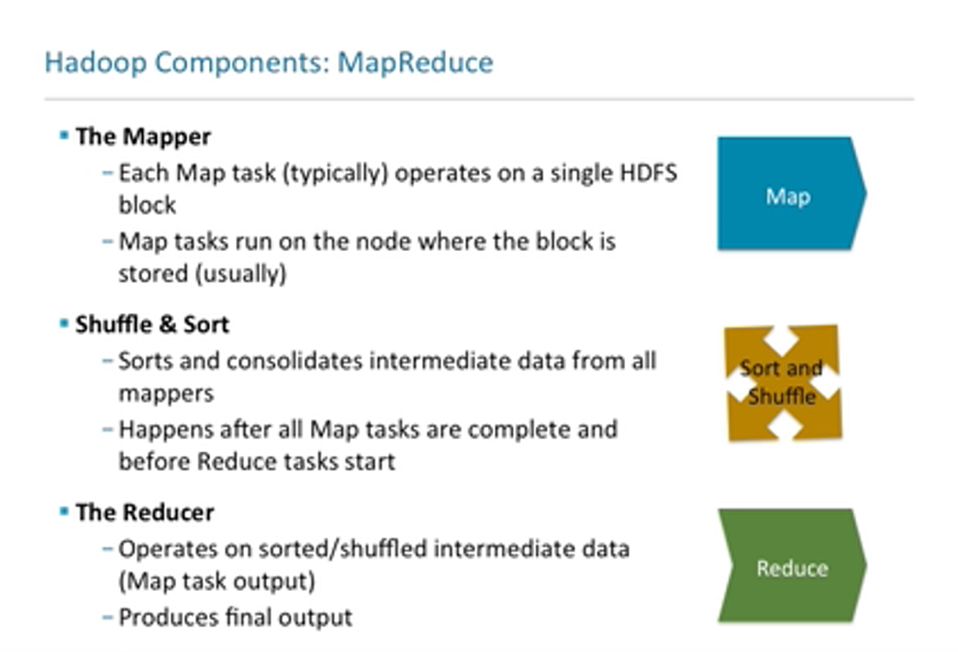

Slide 65
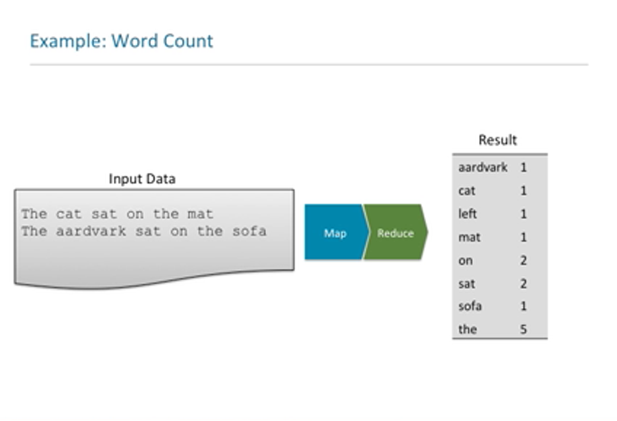

Slide 66
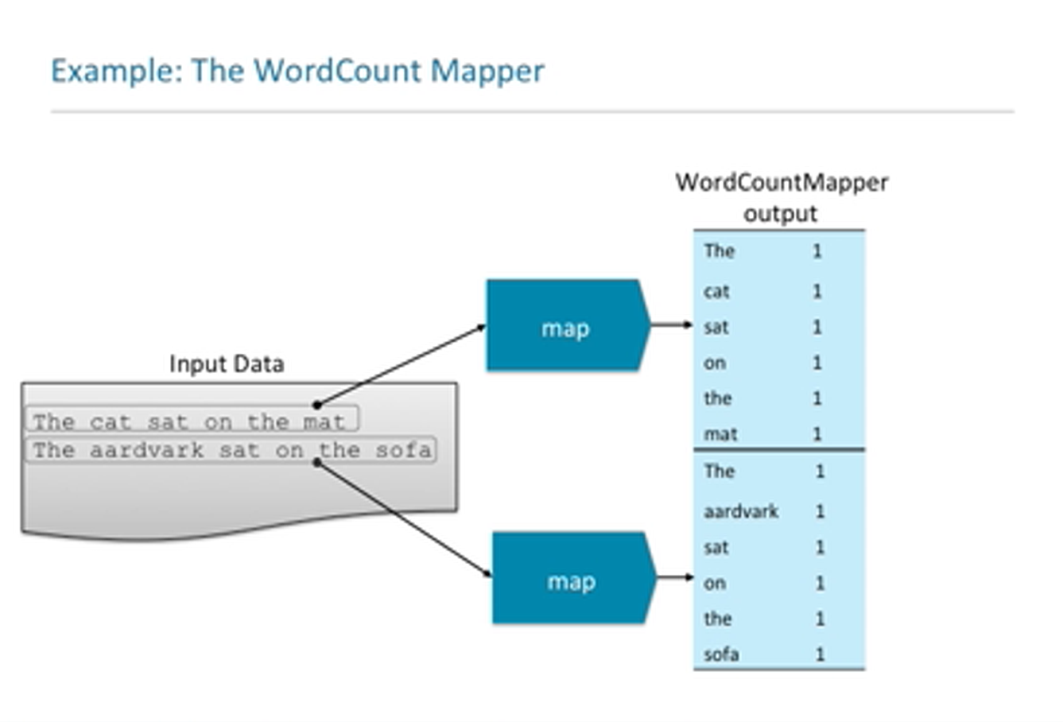

Slide 67
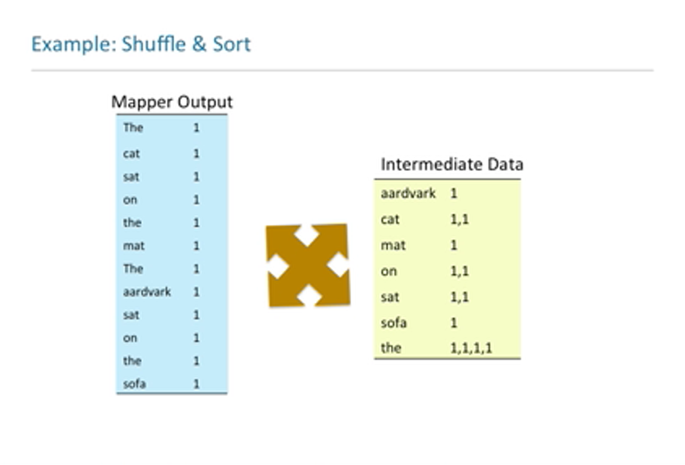

Slide 68
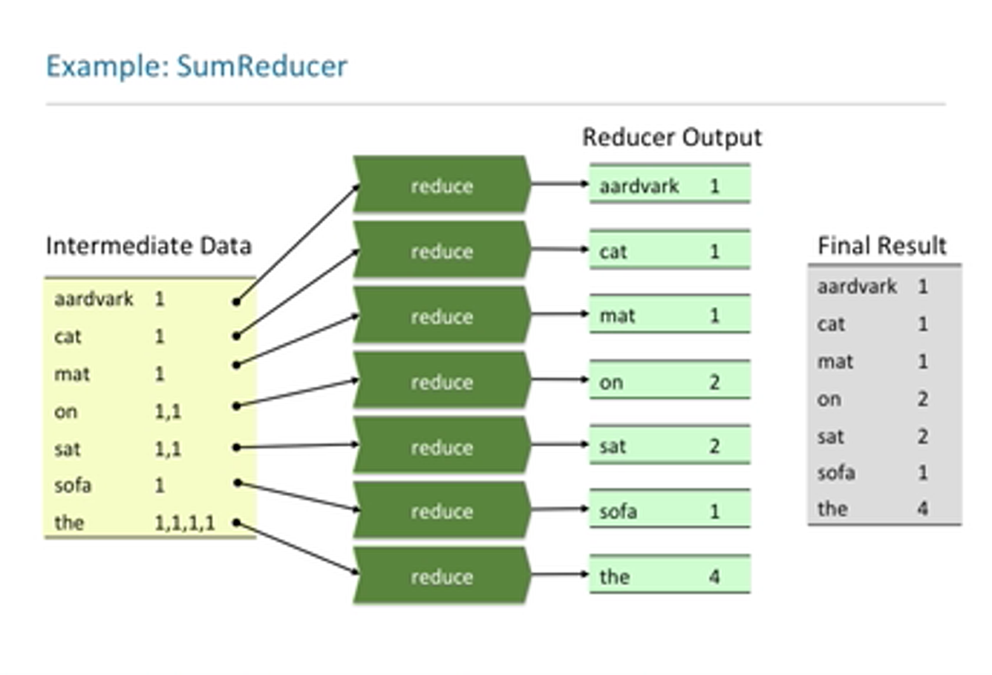

Slide 69
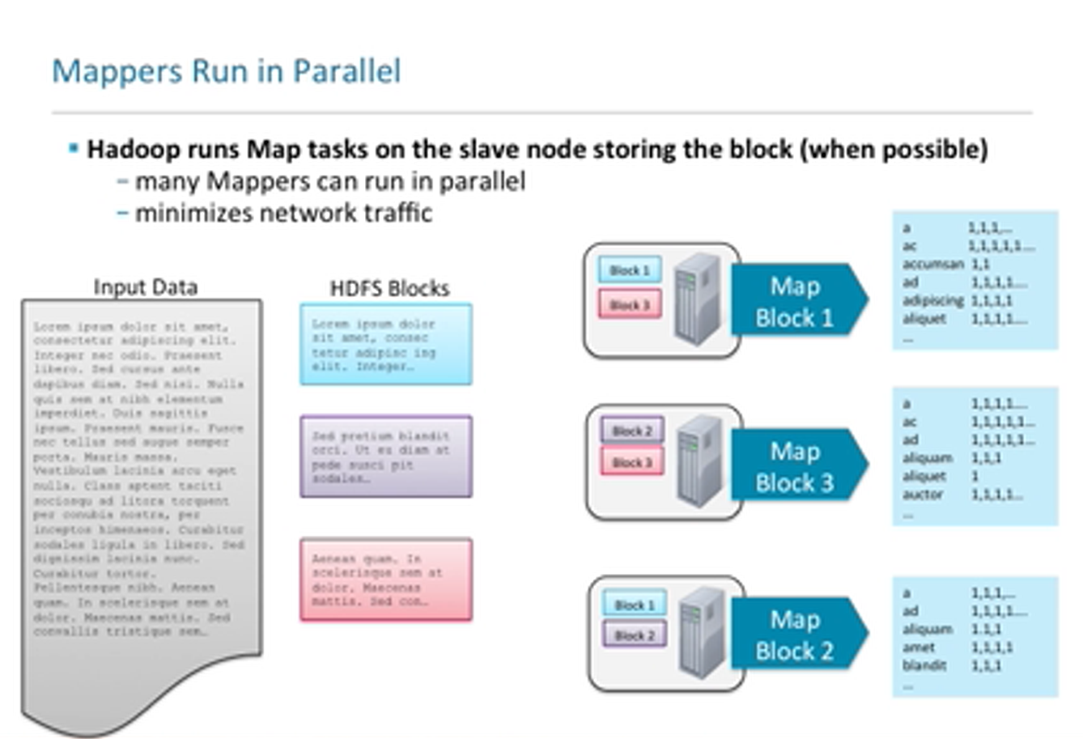

Slide 70
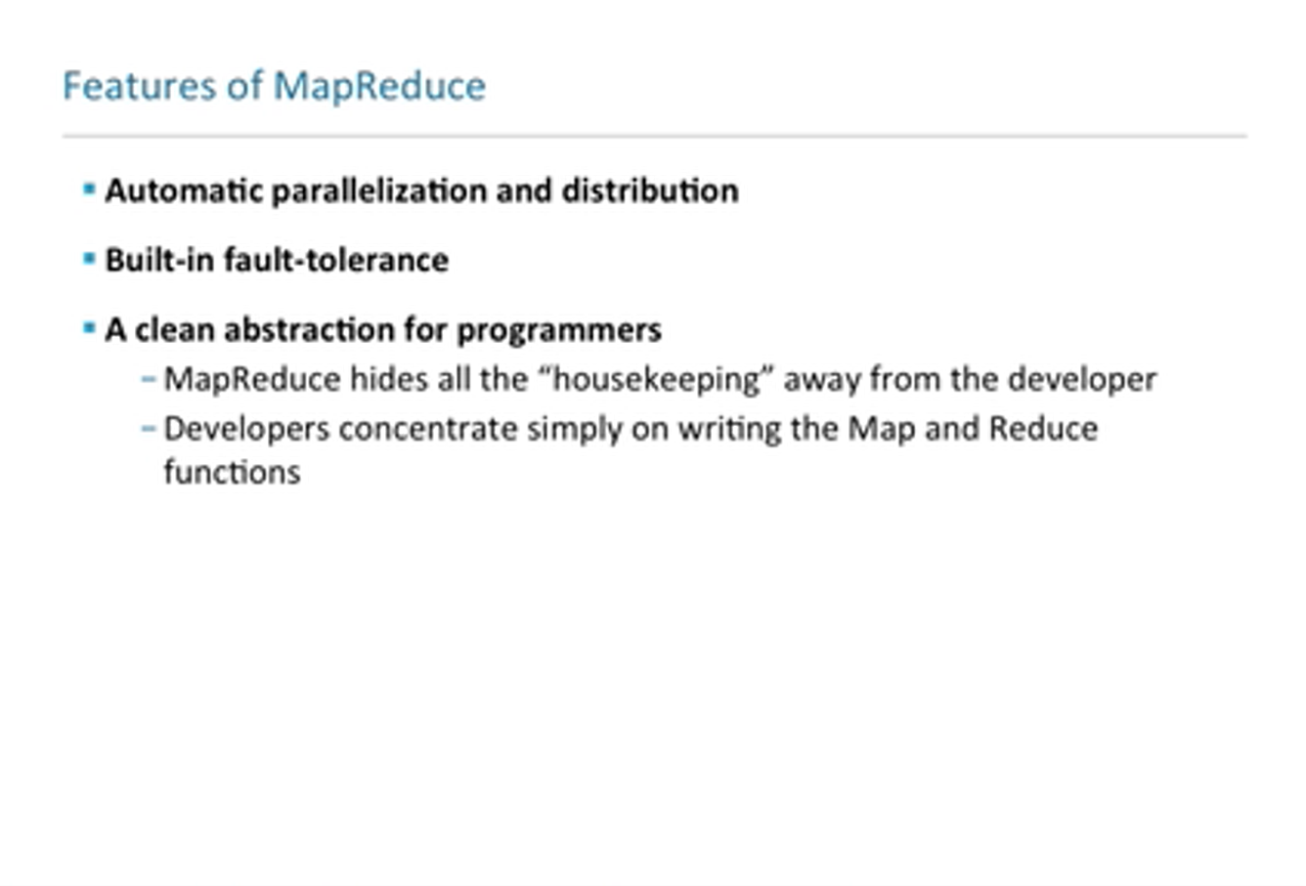

Slide 71
How to interact with Hadoop?

Slide 72

Job execution workflow

Slide 73
Job management - YARN
Daemons running in the Hadoop Cluster. Daemons are the light-weight process that runs in the background.
1. Master Daemons
NameNode: It is the master Daemon in Hadoop HDFS. It maintains the filesystem namespace. It stores metadata about each block of the files.
ResourceManager: It is the master daemon of YARN. It arbitrates resources amongst all the applications running in the cluster.
2. Slave Daemons
DataNode: DataNode is the slave daemon of Hadoop HDFS. It runs on slave machines. It stores actual data or blocks.
NodeManager: It is the slave daemon of YARN. It takes care of all the individual computing nodes in the cluster.

Slide 74

Job manage interface YARN

Slide 75
4. Applications
Word count
Log analysis

Slide 76

Word Count – the code of Hadoop

Slide 77

Log analysis

Slide 78
Summary
Clouds computing provide computation and storage for information systems
BDA provides new approach for huge computation demand in many IR methods such as TF-IDF, PageRanking, …
Clouds computing: service/platform/infrastructure as a service (pay as you go)
MapReduce provides massive parallel computing for simple and repeated computing like word count. Log count.

